Slide 1

GS1 Standardization Supply Chain - Data Platform Certification & Compliance Framework for developing nations
Kalpana G

Slide 2
PROBLEM STATEMENT I HAVE TAKEN :
How can standards and technology empower shorter supply chains to improve versatility and resilience?

Slide 3
Typical data scenario in Supply Chain companies in developing nations :
The Data Platforms for supply chain systems are typically built on SQL Server, Oracle, Mongo DB etc.
The companies maintain the product masters, categories, locations etc. in these databases
Seldom are the data and operations teams aware , if the products, categories, locations etc. are GS1 compliant to reap the benefits of Global trade
My Solution to make the data platform GS1 compliant :
GS1 Certification and Compliance Framework is an AI powered framework that reads and compares the data with GTIN, EAN/UPC, GLN, GPC, SSCC, EPCIS Masters and finds the percentage of matches
The Framework suggests a recommendation going forward for making the Data Platform GS1 Compliant
The Framework provides authenticity Certifications to Supply Chain companies once all the data and standards in the databases are GS1 compliant
Solution for expanding the adoption of GS1 standards in developing nations

Slide 4

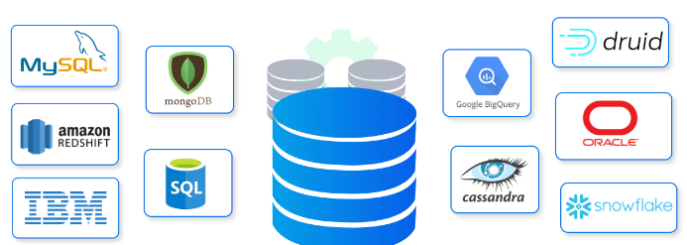
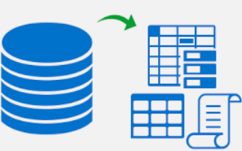

Design for the GS1 Certification Framework
Solution for expanding the adoption of GS1 standards in developing nations
Verify GTIN Compliance
Verify GLN Compliance
Verify GPC Compliance
Verify SSCC Compliance
Verify EPCIS Compliance
STEP 1:
Connect to Supply Chain Databases like Logistics, Inventory, Manufacturing, Vendors, Invoices etc.
STEP 2:
Extract Master Information
Like location, Products, Categories etc.
STEP 3:
Analyse and Report “GS1 Global Data Model” Compliance
STEP 4:
Provide Compliance Recommendations or Certification

Slide 5
How this Framework benefits the Supply Chain Companies and GS1
Impact:
The Framework can directly provide a compliance score ensuring betterment opportunities for Supply Chain companies to GS1 standards
Implementation:
The Framework is a Software-as-a-Service implementation leveraging Simple Google Sheets. Any company can adopt the software in a day !
Technical Execution:
The execution is a Low Code-No Code application built with Google Sheets, AppScript and Python Micro-services on Google Cloud
Anybody with experience of Excel/Google Sheets can use the application
The Prototype is fully functional Cloud Prototype
Solution highlights the use of GS1 Standards:
Solution is fully customized and built on GTIN, EAN/UPC, GLN, GPC, SSCC, EPCIS standards of GS1

Slide 6

Thank You

